Slide 1

ST.ANN’S COLLEGE OF ENGINEERING AND TECHNOLOGY
DEPARTMENT OF ELECTRICAL AND ELECTRONICS ENGINEERING
SOLAR AND FC GRID-CONNECTED
HYBRID SYSTEM USING
BUCK OPERATION
Project Associates:
T.S.S.R.Swaroop 10F01A02A9
Y.V.Subbamma 10F01A02C0
R.Rajendra Babu 11F05A0220
SK.Saleem Malik 10F01A02A6
Under the guidance of
Mr.M.Naveen Babu M.Tech

Slide 2
ABSTRACT:
This paper presents a method to operate a grid connected hybrid system.
The hybrid system composed of a PV array and a PEMFC is considered.
PV array normally uses a MPPT technique to deliver maximum power which makes it uncontrollable.
In coordination with PEMFC, the hybrid system output makes it controllable.
The coordination of PV array and PEMFC makes the hybrid system more stable also improving its performance.

Slide 3
CONTENTS:
Introduction
Existing System
Schematic Diagram
Operating strategies
Simulation Diagram
Simulation Results
Conclusion

Slide 4
INTRODUCTION:
Now-a-days renewable energy is widely used. One of them is solar energy.
The disadvantage of the PV array is that the output power makes it an uncontrollable source.
In order to overcome this, PEMFC should be installed in the hybrid system which makes it controllable.
There are two control modes of UPC and FFC in the hybrid system.
The coordination of these two control modes makes the hybrid system more stable.

Slide 5
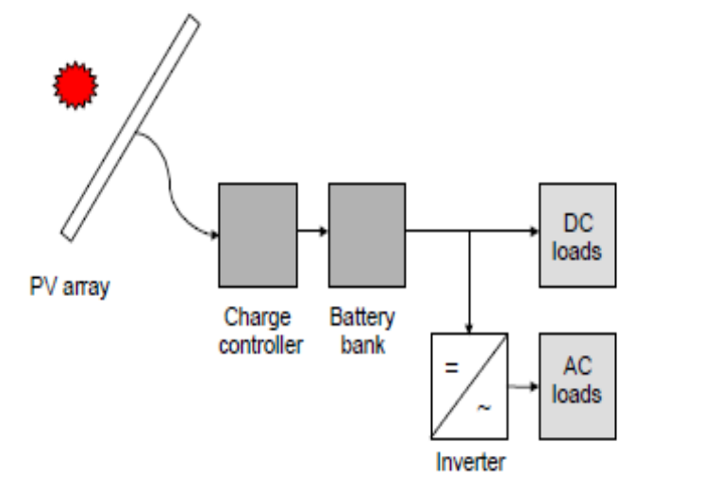
EXISTING SYSTEM:
IEXISTING SYSTEMSTINGYSTEM
There exists a standalone PV system supplying power to load.
PV systems run on the basis of MPPT principle.
This produces an uncontrolled output.
But we need a controlled output as PV system does not run during night time.
Fig: Photovoltaic System
i Photovoltaic System
Fig: Photovoltaic System
System

Slide 6
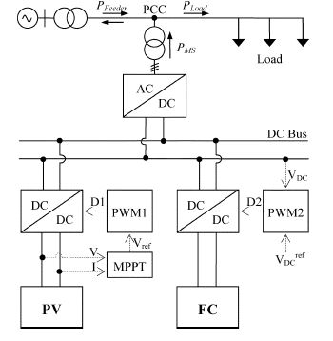
SCHEMATIC DIAGRAM:

Slide 7
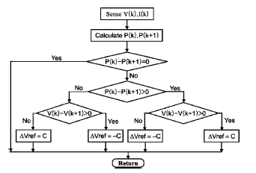
MPPT ALGORITHM:

Slide 8
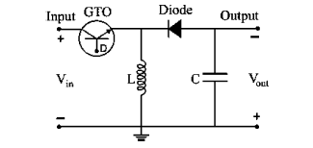
BUCK TOPOLOGY:
Buck converter mainly step downs the input DC voltage.
It mainly operates using any of the power devices like GTO,MOSFET,IGBT.
Here GTO switch is used rather than MOSFET due to high rating criteria.
Capacitor is used at load section to reduce the ripples in the output voltage.

Slide 9
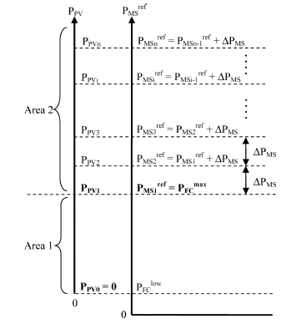
OPERATING STRATEGY IN UPC MODE:

Slide 10
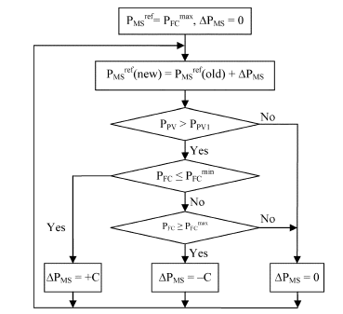
CONTROL ALGORITHM IN UPC MODE:

Slide 11
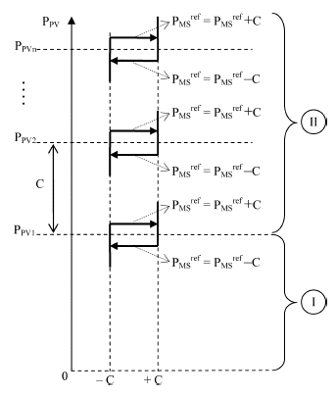
HYSTERESIS CONTROL SCHEME:

Slide 12
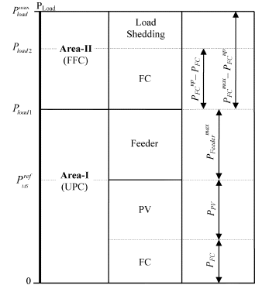
OVERALL CONTROL STRATEGY:

Slide 13
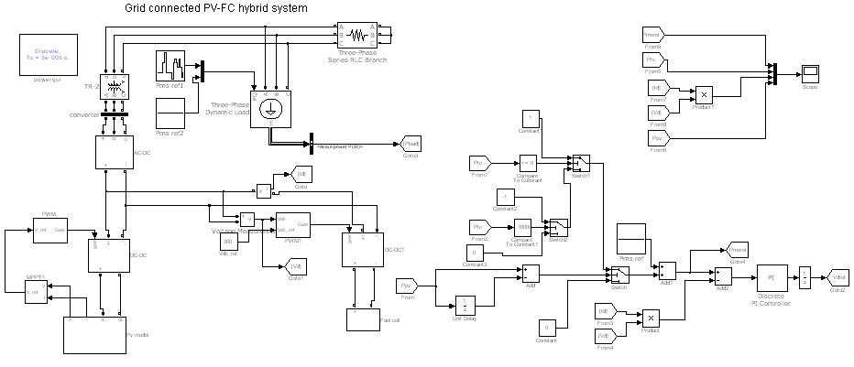
SIMULATION DIAGRAM (CASE I):

Slide 14
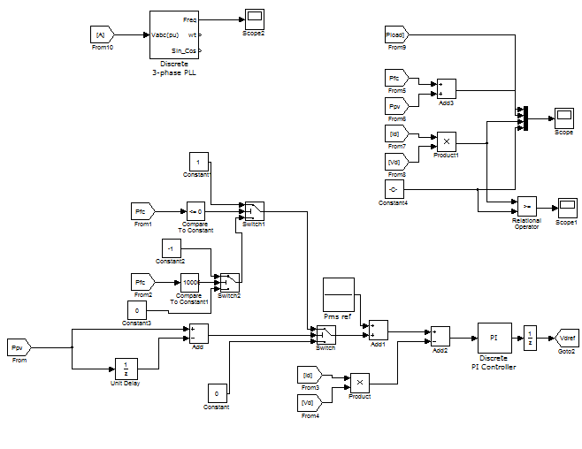
Case II:

Slide 15
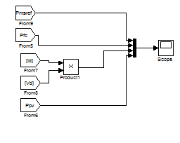
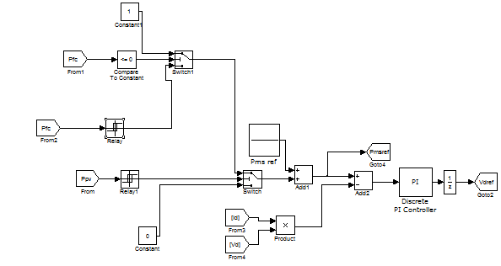
Case III:

Slide 16
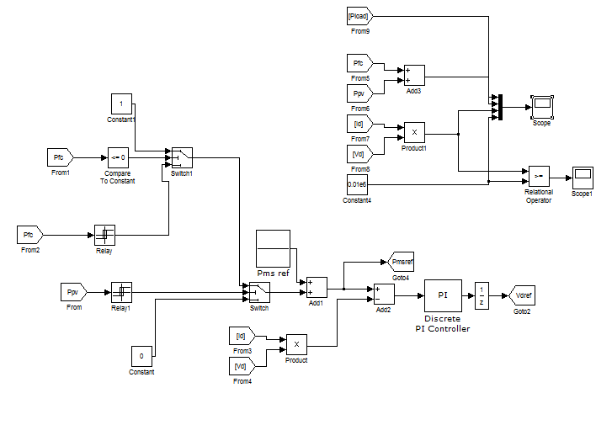
Case IV:

Slide 17
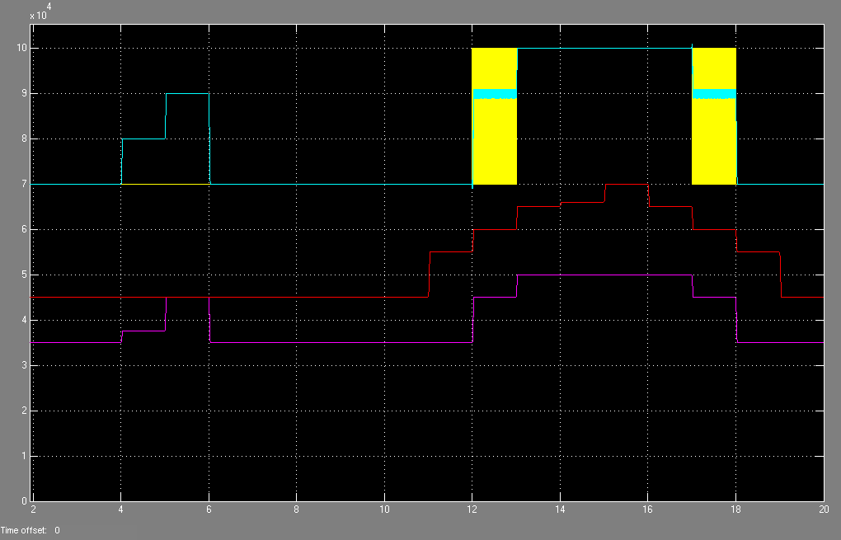
OPERATING STRATEGY OF HYBRID SOURCE WITHOUT HYSTERESIS:

Slide 18
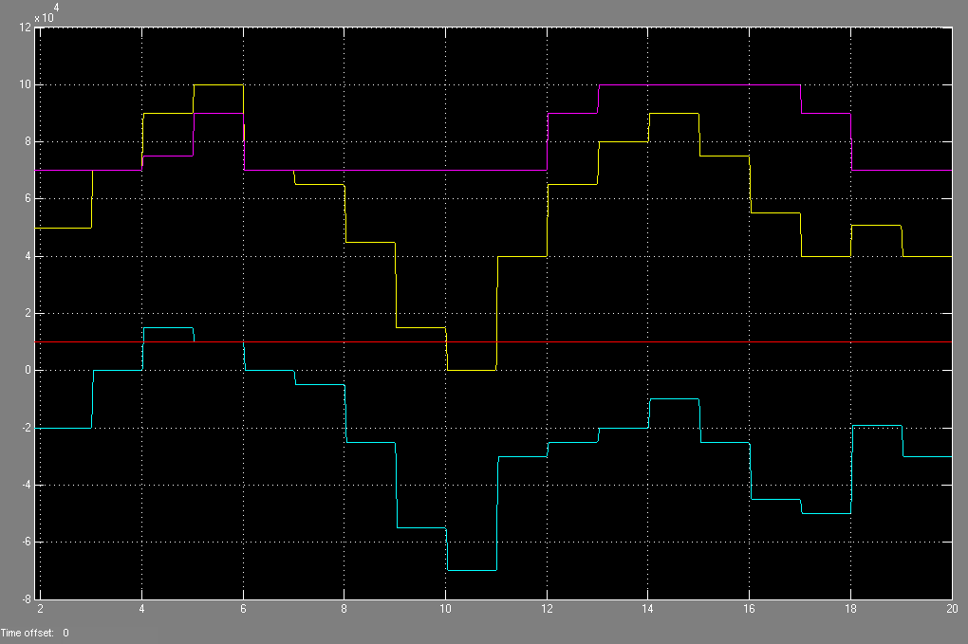
OPERATING STRATEGY OF WHOLE SYSTEM WITHOUT HYSTERESIS:

Slide 19
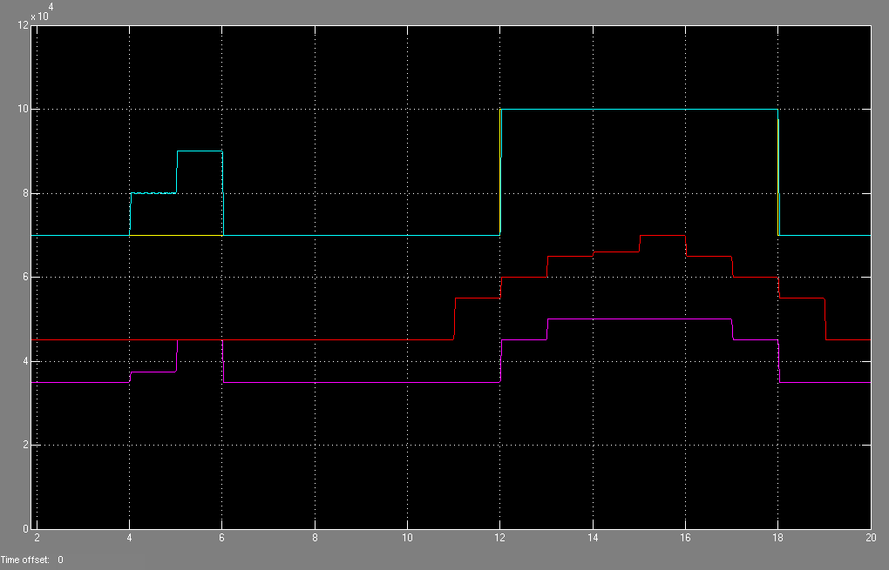
OPERATING STRATEGY OF HYBRID SOURCE USING HYSTERESIS:

Slide 20
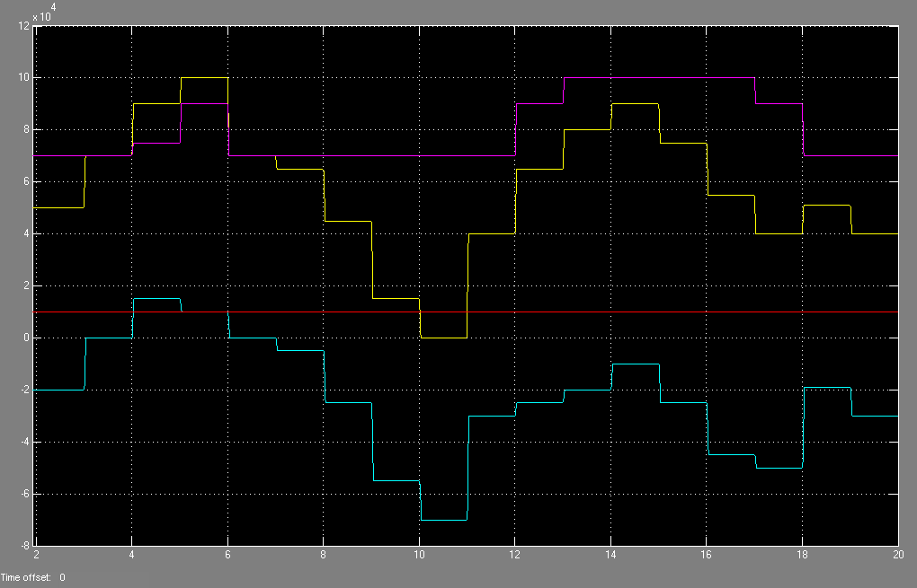
OPERATING STRATEGY OF WHOLE SYSTEM USING HYSTERESIS:

Slide 21
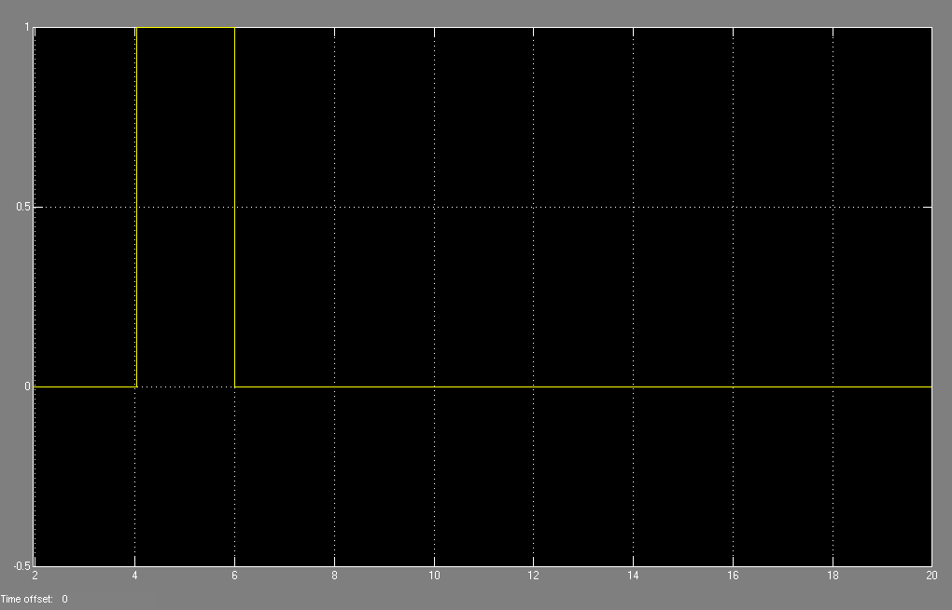
CHANGE OF OPERATING MODES:

Slide 22
CONCLUSION:
The hybrid system comprising of PV array and PEMFC became more stable and got improved performance with the coordination of UPF and FFC control modes operating PV at its MPPT and FC output in its high-efficiency performance band.

Slide 23
Future scope:
In future, if we have an involuntary deficient of conventional energy resources, then hybrid systems consisting of solar plant, fuel cells etc., of non-conventional energy resources would play a major role in the power generation which would be more economical if the operating strategies are well co-ordinated with the energy resources.

Slide 24

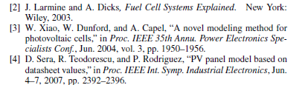

REFERENCES:

Slide 25


